Slide 1
















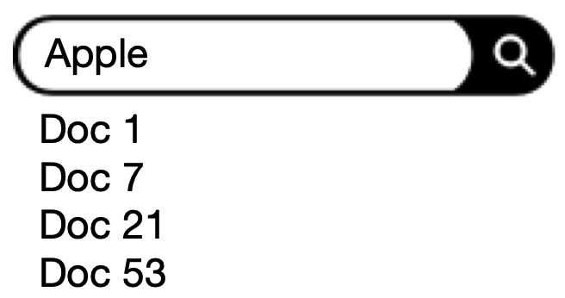












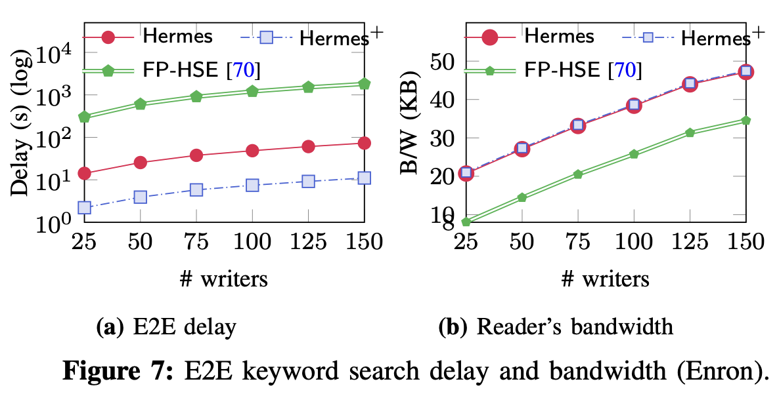

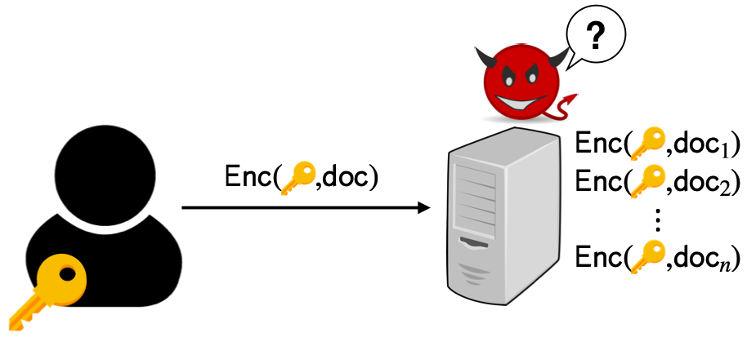








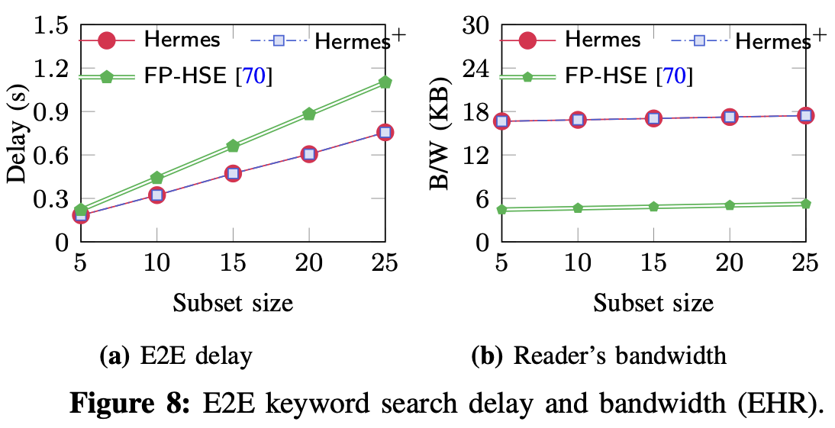
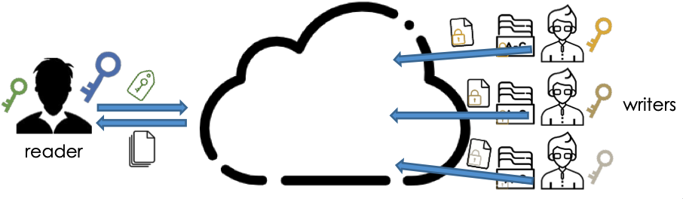









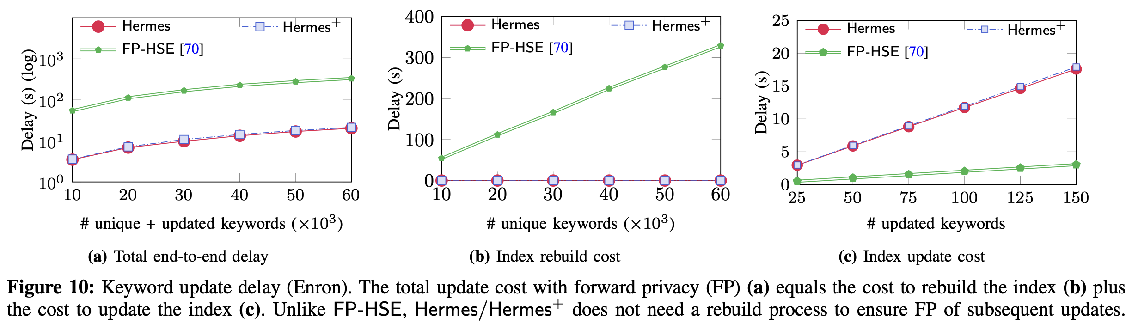


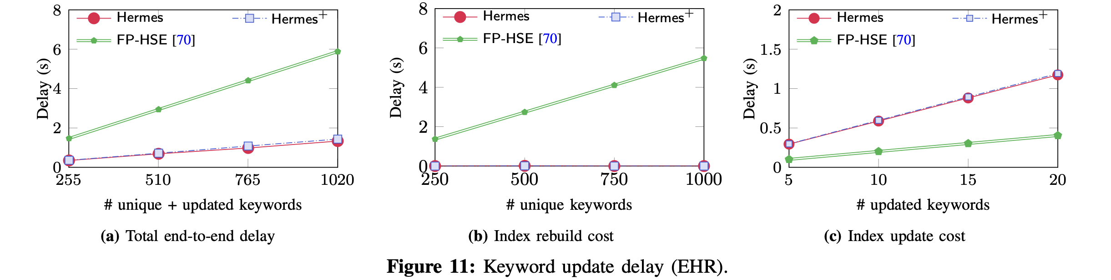



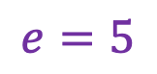



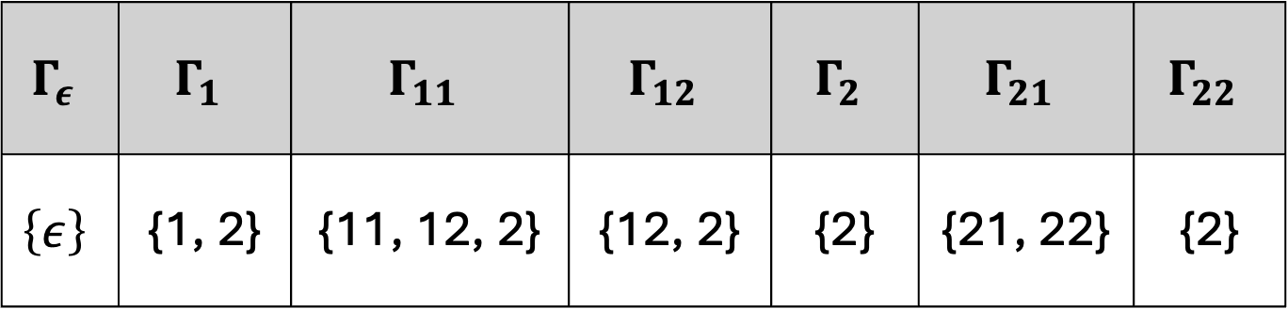


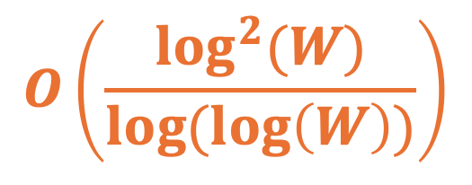

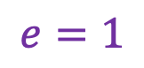
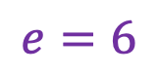




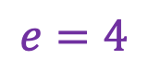

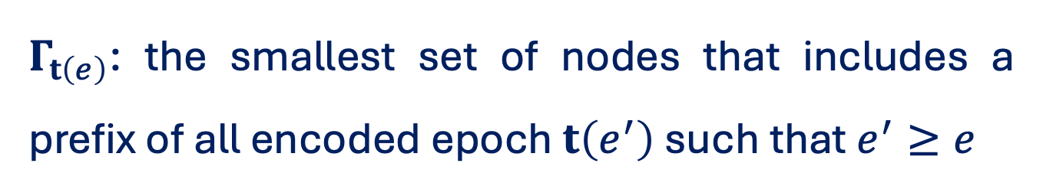
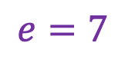





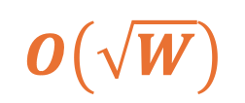

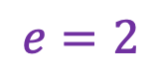

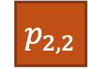



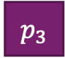


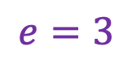





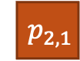
Hermes: Efficient and Secure Multi-Writer Encrypted Database
Tung Le, Thang Hoang
Department of Computer Science, Virginia Tech
SEARCHABLE ENCRYPTION: AN OVERVIEW
IDEA 1: HIDDEN-ID COUPLING KEY-AGGREGATE ENCRYPTION
EXPERIMENT RESULTS
Users expect the ability to execute search
?
Keyword search: 21.2× ⁃ 163.8× faster than state-of-the-art
A New Primitive: Hidden-ID KAE, which can prevent keyword-guessing attacks
Remarkable Features: Confidentiality, Anonymity, and Aggregated-Key with Hidden-ID
Challenge: server cannot decrypt data to search
IDEA 2: PARTITIONING FOR SUBLINEAR SEARCH
$${ w}_{1}$$
$${ w}_{1}$$
$${ w}_{2}$$
$${ w}_{2}$$
$${ p}_{1}$$
$${ w}_{3}$$
$${ w}_{1}$$
SYSTEM, THREAT AND SECURITY MODELS
$${ w}_{4}$$
Recursive
Partitioning
$${ p}_{2,1}$$
$${ w}_{2}$$
$${ w}_{3}$$
Partitioning
$${ p}_{2}$$
$${ w}_{5}$$
$${ p}_{1,1}$$
Keywords
…
$${ w}_{6}$$
$${ p}_{2,2}$$
$${ w}_{3}$$
$${ w}_{n−1}$$
$${ p}_{3}$$
$${ w}_{7}$$
$${ w}_{4}$$
$${ w}_{n}$$
$${ w}_{8}$$
$$O\left(\frac{\log^{2}(W)}{log(log\left(W\right))}\right)$$
$$O\left(W\right)$$
$$O\left(\sqrt{W}\right)$$
$${ w}_{9}$$
Keyword update: 3.8× ⁃ 17.1×
faster than state-of-the-art
An honest reader with a public/private key pair
Linear
Partitioning
Recursive Partitioning
Multiple writers, where each owns its independent database
IDEA 3: USER-EFFICIENT FORWARD PRIVACY
A server that stores database of writers and executes queries
$$e=1$$
Security Assumption: The server and some of the writers can be corrupt. The adversary is semi-honest
$$ε$$
$$Γ_{ε}$$ | $$Γ_{1}$$ | $$Γ_{11}$$ | $$Γ_{12}$$ | $$Γ_{2}$$ | $$Γ_{21}$$ | $$Γ_{22}$$
$$\left\{ε\right\}$$ | {1, 2} | {11, 12, 2} | {12, 2} | {2} | {21, 22} | {2}
1
2
Our Contributions:
Enhance security guarantees
Optimize server-side search complexity
Ensure forward privacy without costly rebuild
$$e=2$$
$$1$$
$$2$$
$$e=5$$
1
2
1
2
$Γ_{t\left(e\right)}$: the smallest set of nodes that includes a prefix of all encoded epoch $t\left(e^{′}\right)$ such that $e^{′}≥e$
$$11$$
$$12$$
$$21$$
$$22$$
$$e=3$$
$$e=4$$
$$e=6$$
$$e=7$$
Trade-off: increase $O\left(λ\right)$ in update complexity
Tree-based Epoch Encoding

